Slide 1
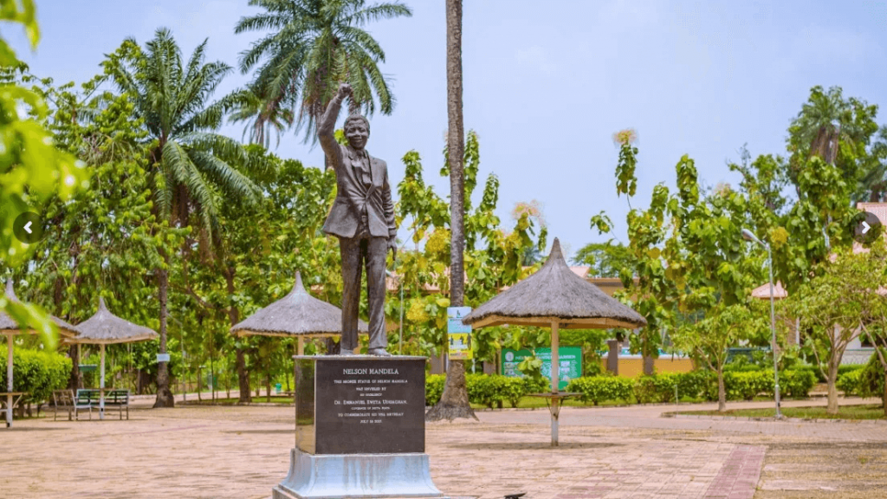
Garden of Freedom
My Favorite Place

Slide 2
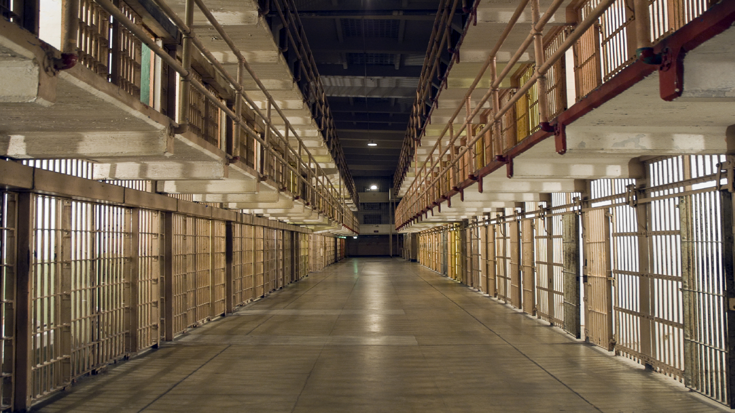
Prison

Slide 3
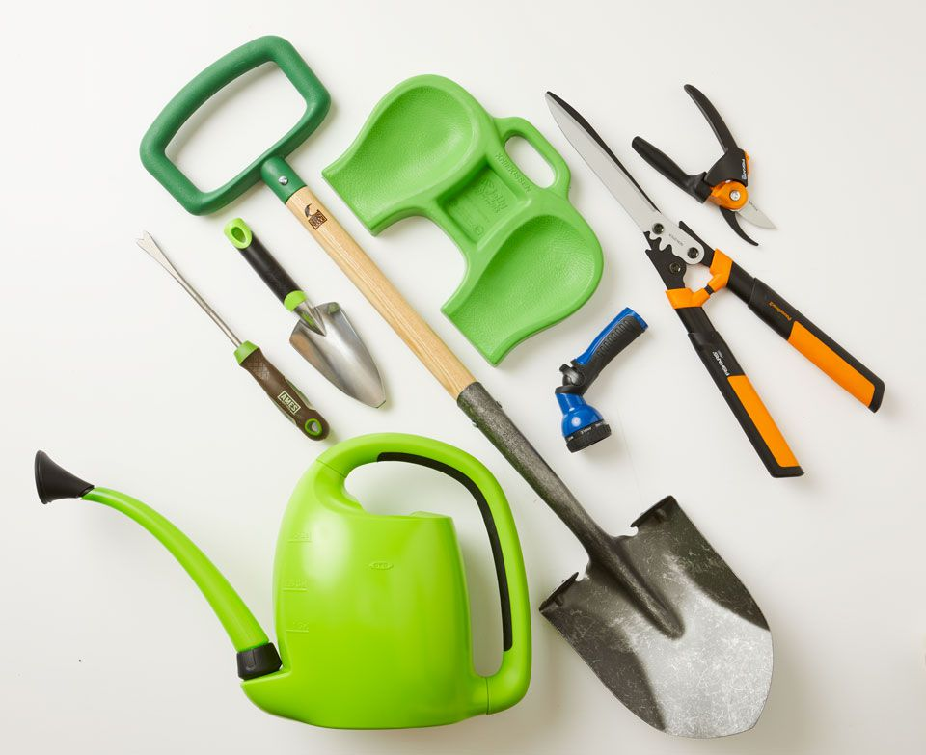
Equipment

Slide 4
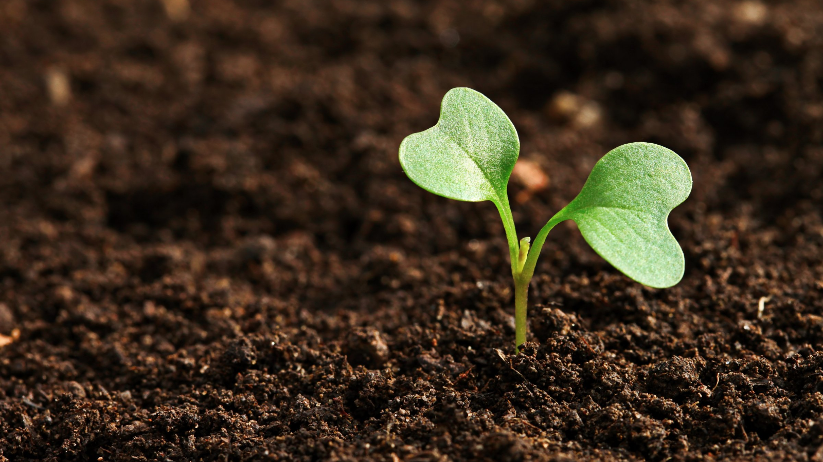
Soil

Slide 5
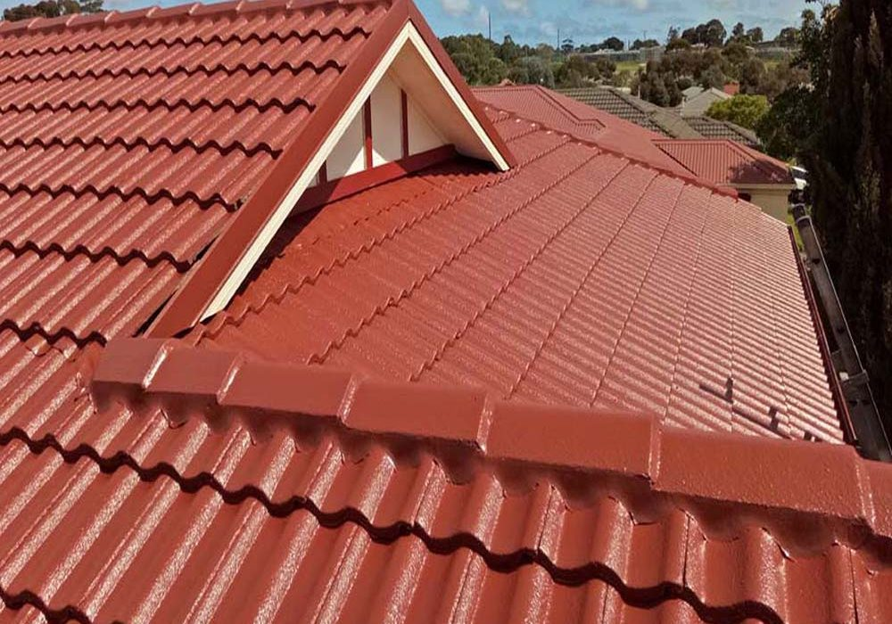
Roof

Slide 6
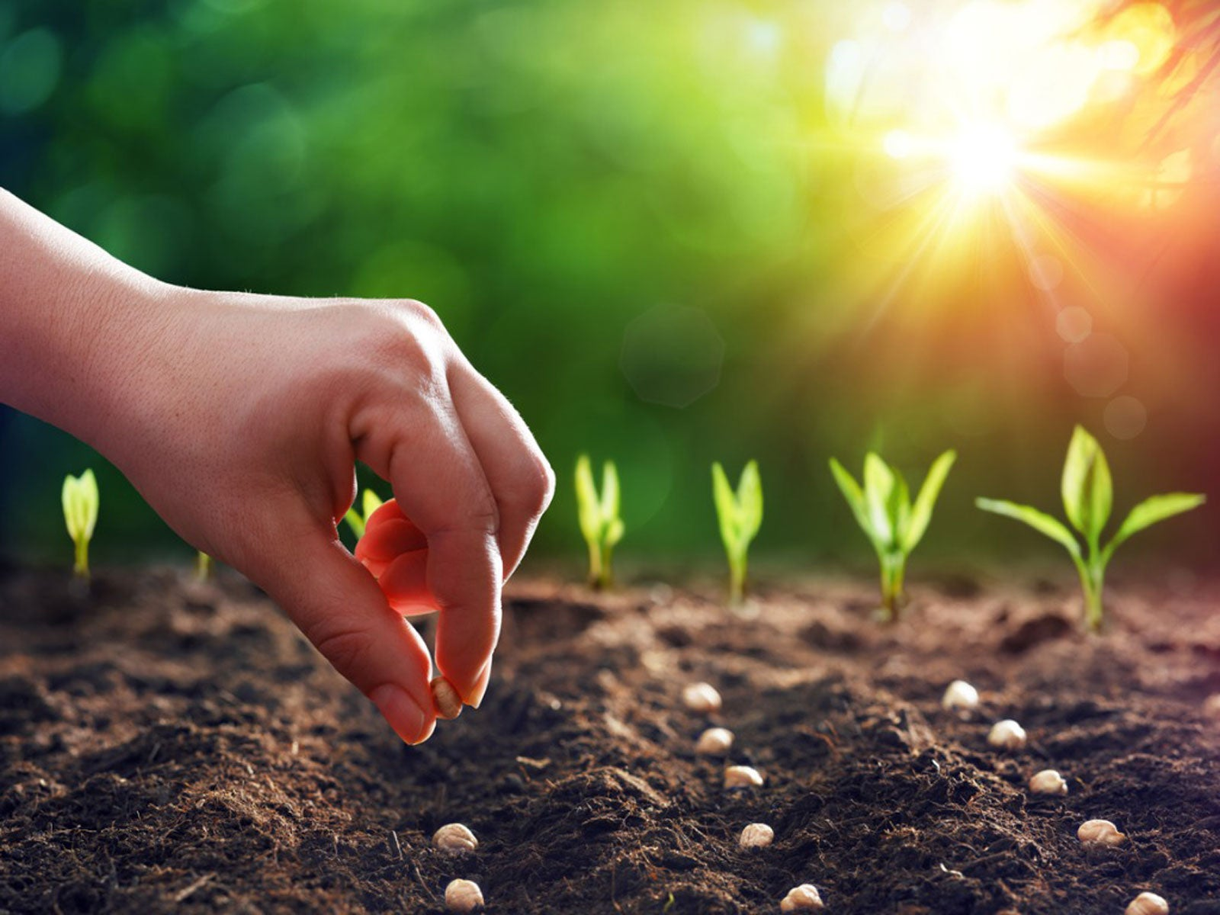
Seed

Slide 7
New Vocabularies
Freed
Massive
Influence
Political
Prison
Inspire
Roof
Equipment
Seed
Soil
Satisfaction
Inspired
Large
Drum

